Slide 1
top and bottom customers
File created on: 3/31/21 12:15:51 PM GMT+05:30

Slide 3
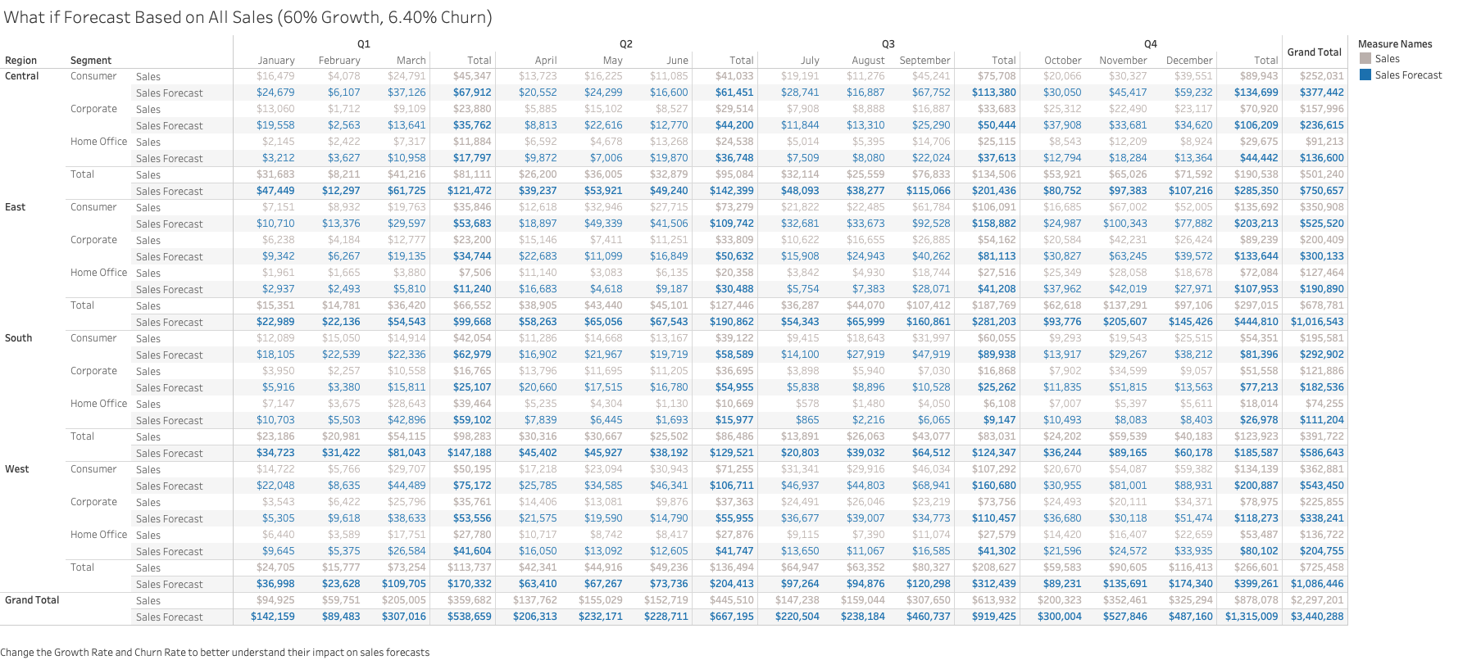

Slide 5
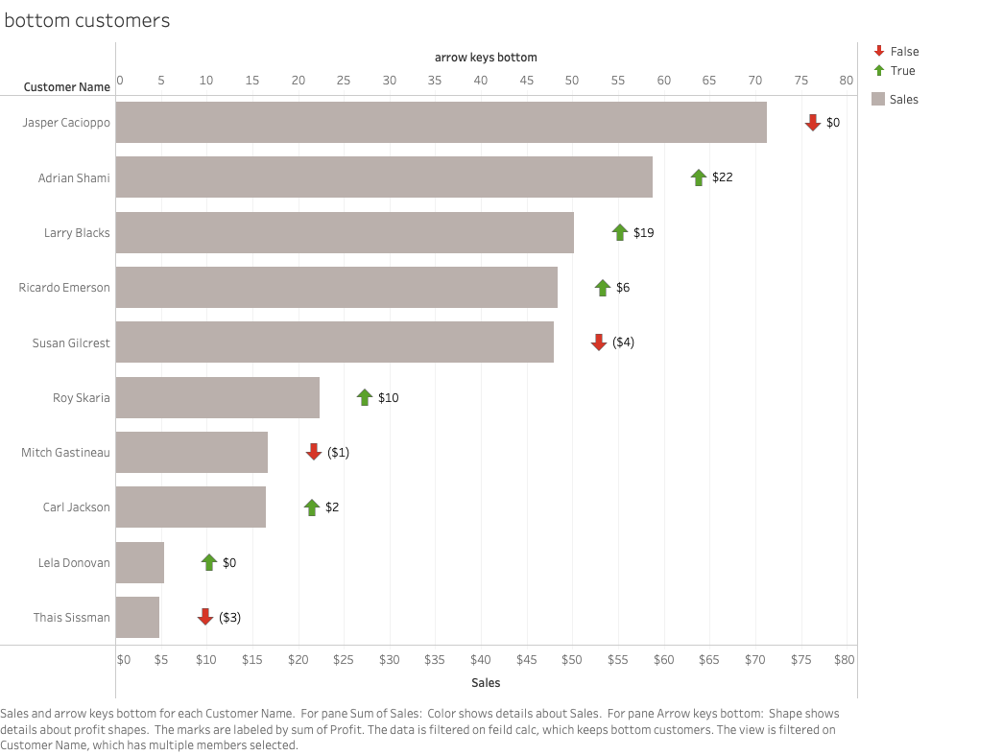

Slide 6
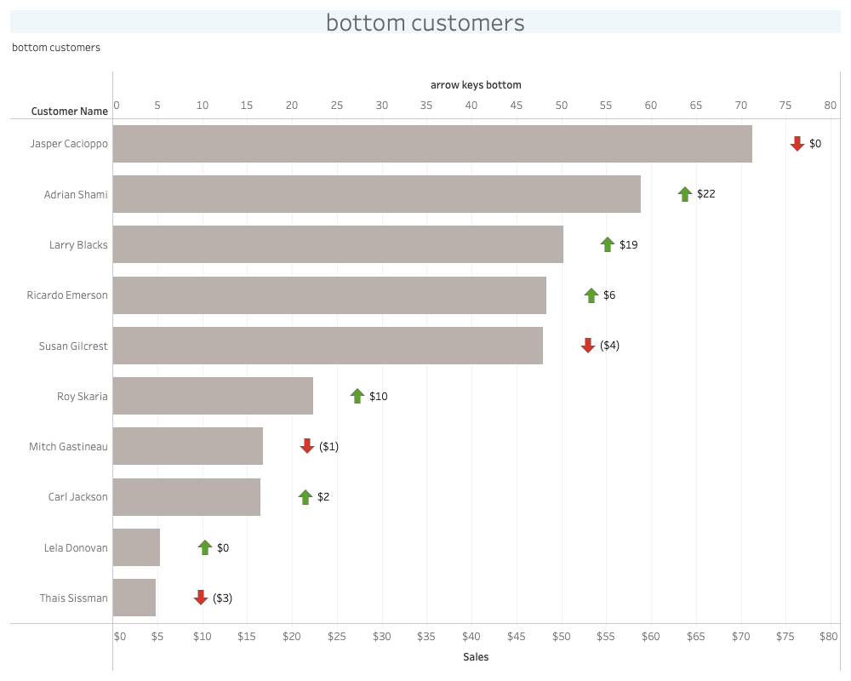

Slide 7
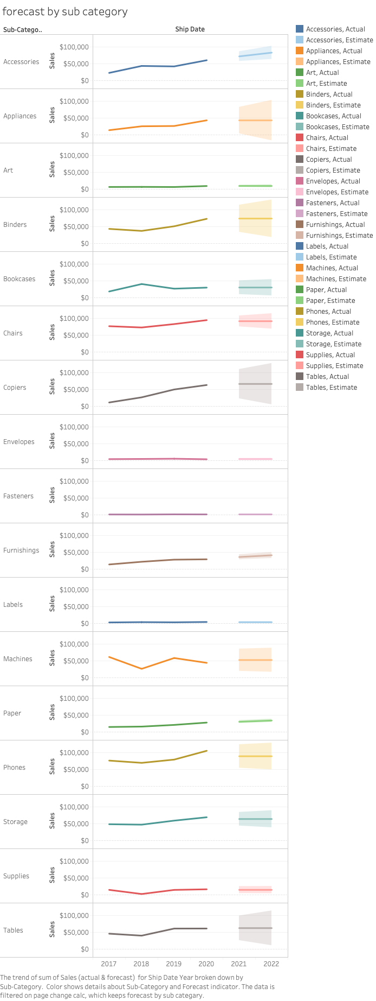

Slide 8
